Slide 1
Pathfinder
Integrating GenAI with Graph Database for the Enterprise

Slide 2


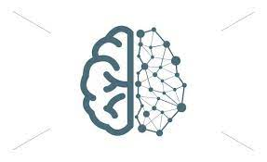
Analyst View on Gen AI, Graph DB & Ontologies
By 2025,
10% of all global data produced will come from generative AI.
Users expect answers to the questions, not list of links to resources that might get the answers
By 2025,
graph technologies will be used in 80% of data and analytics innovations
75% of Fortune 500 companies are actively engaged in semantics initiatives as part of the data strategy
Text Generation
Data Augmentation
3D Model Generation
Speech Generation
Image, Music and Video Generation
Generates human-like text based on input prompts or context.
Generates synthetic data to augment existing datasets for training machine learning models.
Generates 3D models for designs, virtual environments, and simulations.
Generates human-like speech and can be used for text-to-speech synthesis, voice assistants,
Generates, Image, Music and Video as per the prompts provided

Slide 3
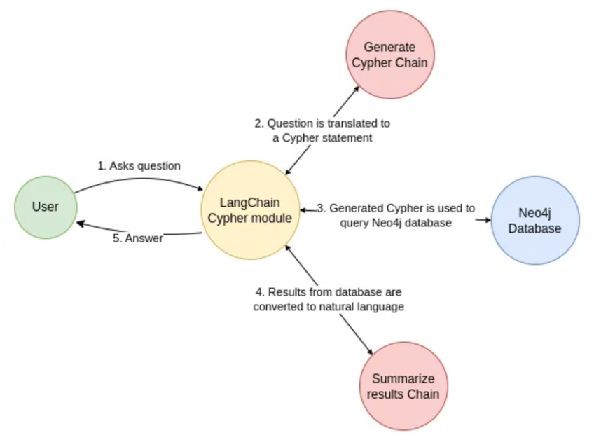
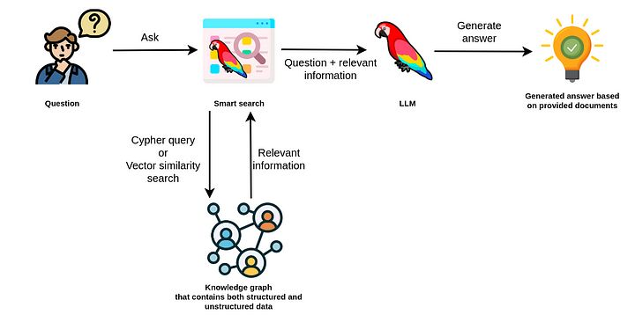
Pathfinder - Use Case

Slide 4
Gen AI – Challenges it poses
Implicit Knowledge / Knowledge Cut off
Hallucination
Indecisiveness
Lack of enterprise domain knowledge
Reasonable answers but not always accurate

Slide 5
Shortcomings of Traditional RDBMS
SQL models tables and keys, not business concepts
SQL lacks support for complex types
SQL has poor support for abstraction and reuse
SQL schemas are rigid, its difficult to add new relationships without schema surgery
No good way to express business rules and constraints

Slide 6
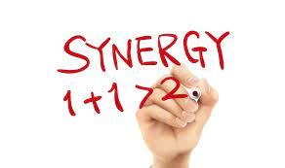

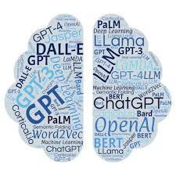
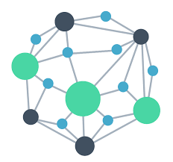

Why use Graph for Gen AI ?
Structured Data & Relationships
Explainability and Traceability
Support more diverse and complex queries
Consistency Vs Hallucination
Low Latency Retrieval
Language
Statistics
Creativity
Knowledge
Facts
Context

Slide 7
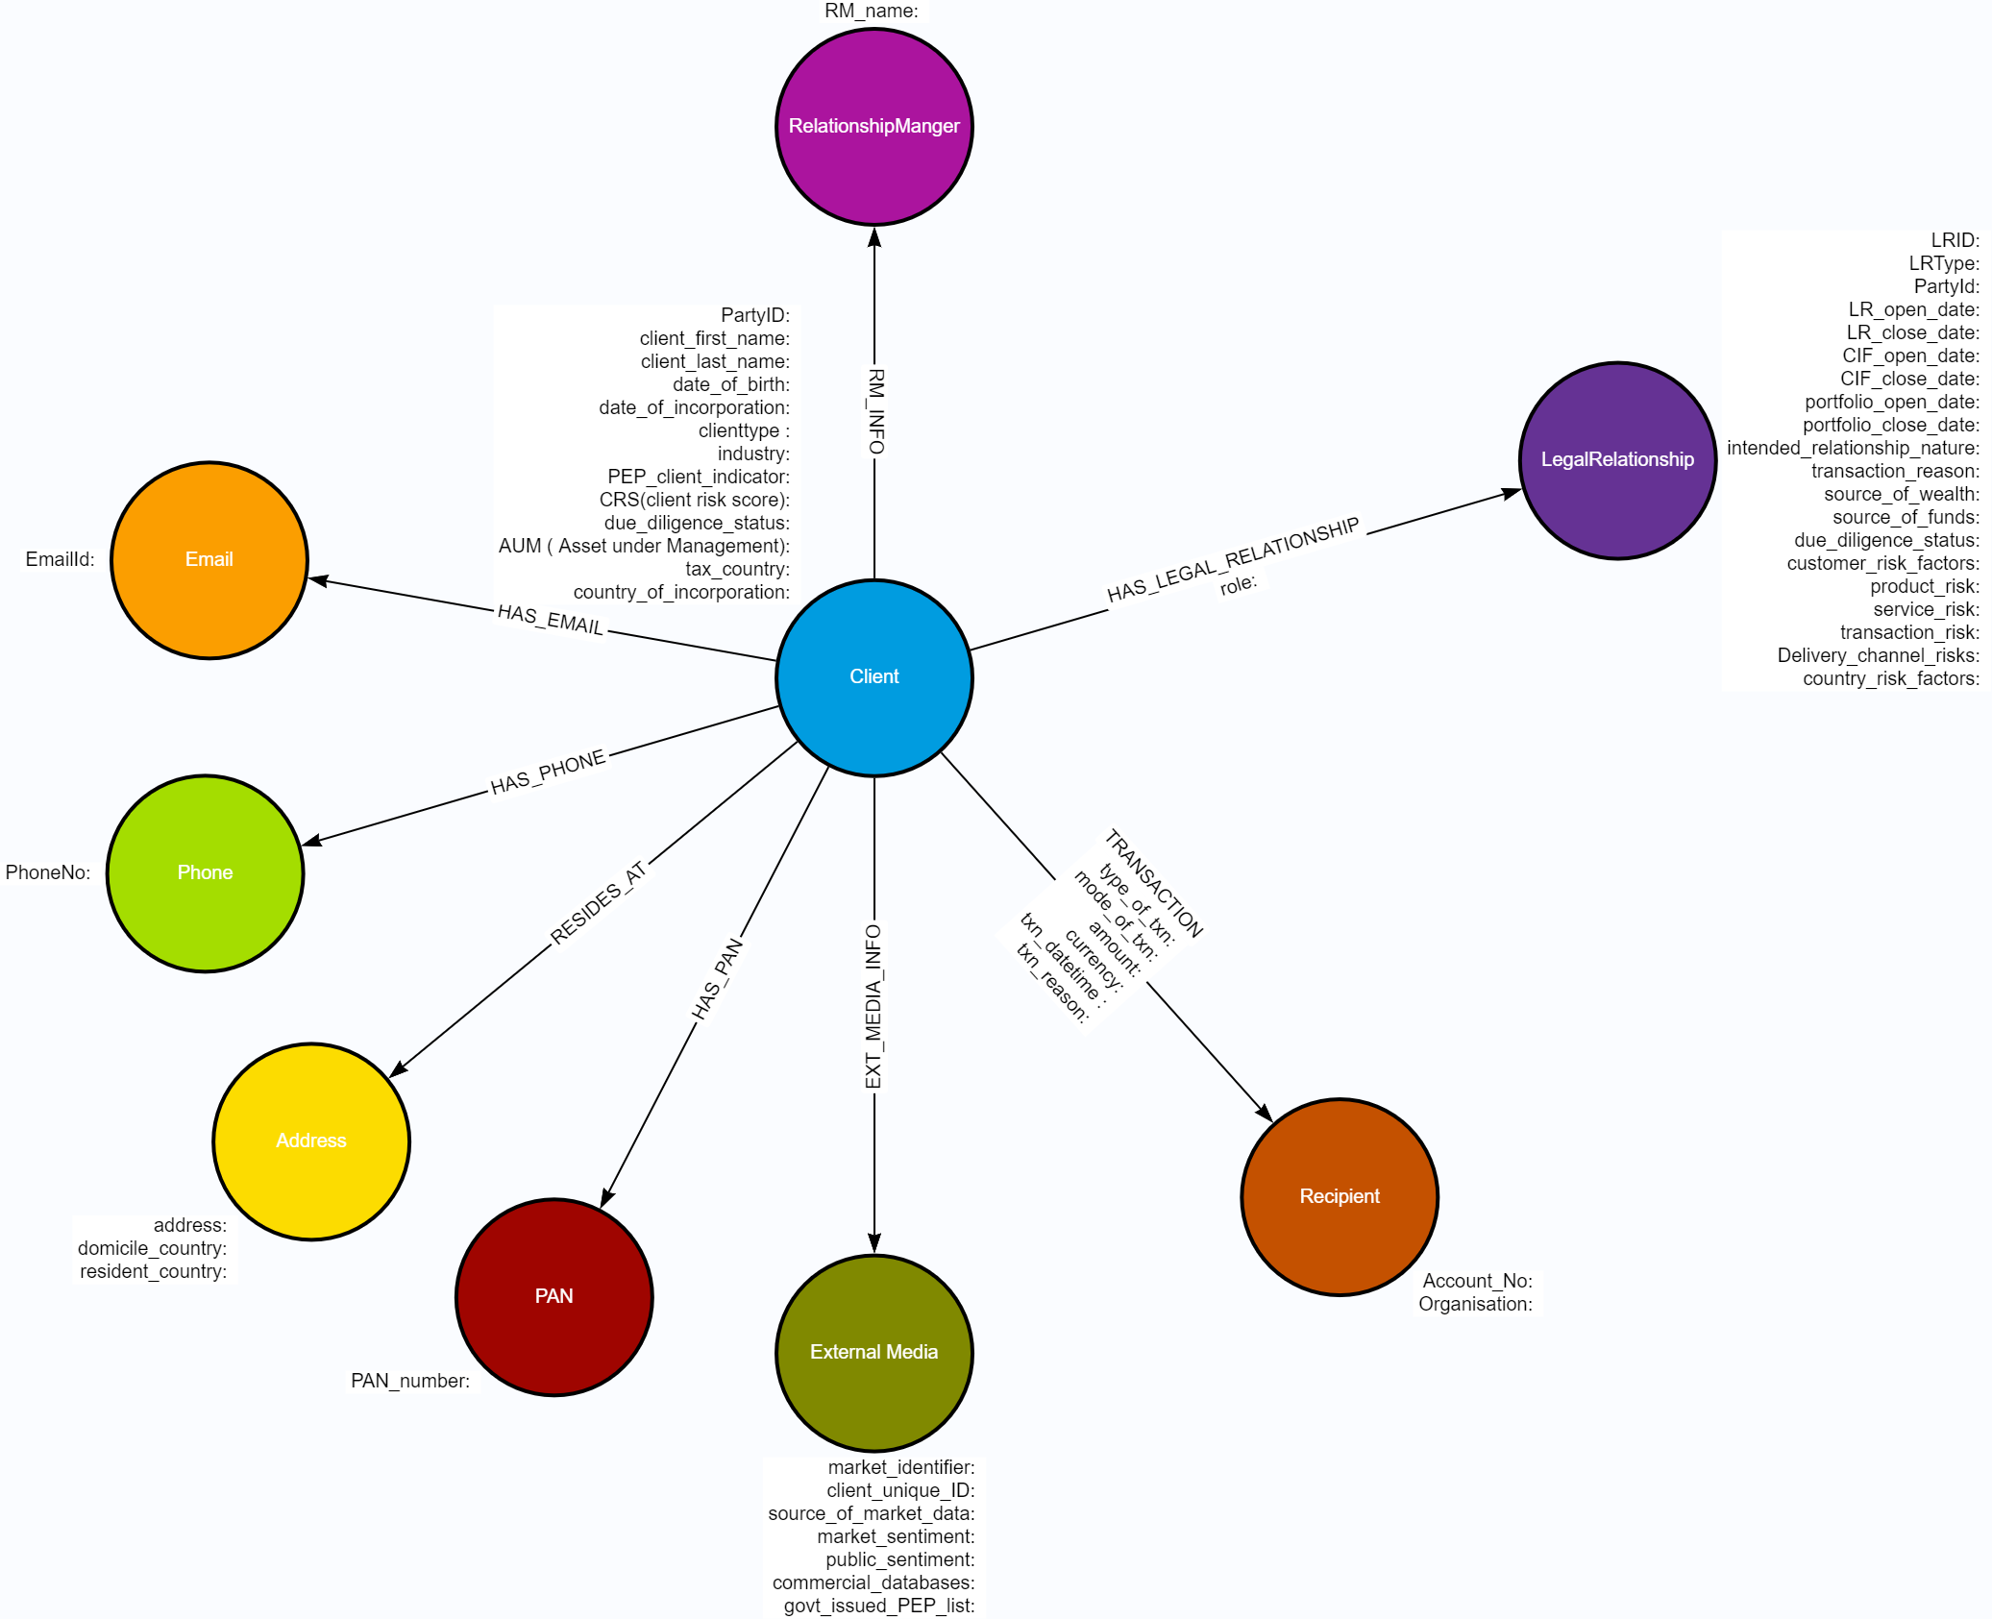
What is a Knowledge Graph ?
A knowledge graph is a database, that models business concepts, the relationships between them and the associated business rules & constraints.

Slide 8
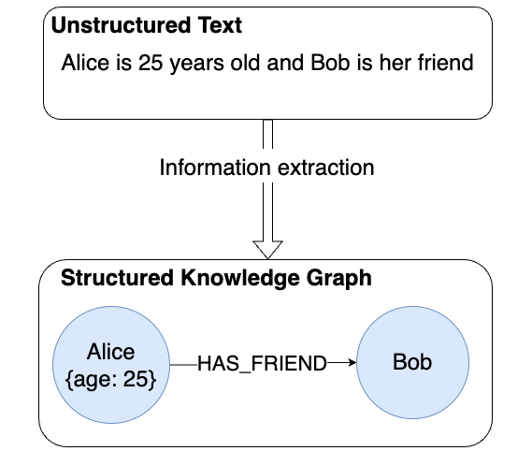
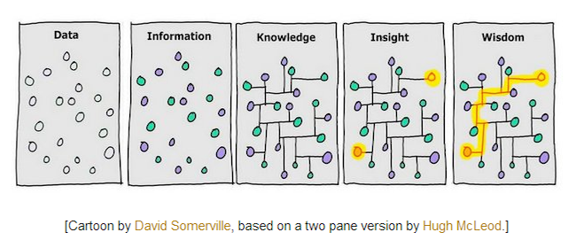
Knowledge Graphs - Triples

Slide 9




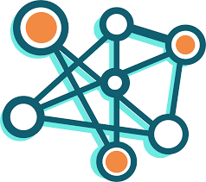
Gen AI for Knowledge Graph Creation
On the Fly Ontologies
Use LLMs for creating of Ontologies which will act as a guide
Entity Resolution
Identify and resolve entity mentions in text by using NLP – Named Entity Recognition (NER)
Relationship Extraction
Extract semantic relationships from text data, uncover implicit relationship between entities
Query Understanding
By integrating Natural Language Understanding (NLU) models with KGs, interpret complex queries expressed in Natural Language
Data Integration
Help to streamline the process of importing data into KG
Predictive Analysis
Gen AI Models can analyze patterns and trends to make predictions and recommendations

Slide 10
Feature Enrichment of Data through GDS
Algorithm Category | Algorithms | Description | Usage | Usage in BFSI
Centrality | Degree Centrality Closeness Centrality Betweenness Centrality Page Rank Article Rank Eigenvector Centrality | Determines the importance of distinct nodes in the network | Outliers, Influencers, Vulnerabilities …. | Fraud Detection Anti-Money Laundering Inform Prioritization during analysis and Investigation
Community Detection | Weakly Connected Components Strongly Connect Components Label Propagation Louvain Modularity | Detects group clustering or partition options | Recommendations, Homophily, Outliers,… | KYC Synthetic identifies Stolen Identifies Fraud Ring Detection Anti-Money Laundering
Similarity | Node Similarity Nearest Neighbors Cosine Similarity | How alike nodes are by neighbors and relationships | Recommendations, What-If Analysis, Disambiguation, … | Entity Resolution Synthetic identifies Stolen Identities
Pathfinding | Shortest Path Random Walk Breadth First Search Depth First Search | Finds Optimal Paths or evaluates route availability and quality | Shortest Path, Optimal Path, Route Optimization,….
Link Prediction | Common Neighbors Same Community Total Neighbors | Estimates the likelihood of nodes forming a future relationship | Link Prediction, Recommendations, Next Best Action ,….

Slide 11
Feature Enrichment – Sample Algorithms
Page Rank
What : Finds important nodes based on their relationships
Why : Identify important or influential client nodes by quantifying the flows of money towards them.
Uses :
Fraud detection
Anti-money Laundering
Inform prioritization during analysis and investigation
Node Similarity
What : Similarity between nodes based on neighbors. Writes a new relationship to the graph
Why : Identify similar nodes who share common pieces of identity
Uses :
Entity Resolution
Synthetic identities
Stolen identities
Weakly Connected Components
What : Finds disconnected community subgraphs in our data
Why : Identify communities based on connections with shared pieces of identify
Uses :
Householding
Synthetic identities
Stolen identities
Louvain Modularity
What : Finds communities in our graph who are connected. Can return intermediate results
Why : Useful for identifying communities based on transaction behavior rather than identity
Uses :
Fraud ring detection
Anti-Money Laundering

Slide 12
Feature Enrichment – Sample Variables
Derived Variables | Explanation
wccId | WCC Community ID
fraudRisk | Fraud Risk users identified from the WCC community detection
sharedIdsDegree | No of users connected with SHARED_IDS relationship
ipDegree | No. of IP nodes connected to the user
cardDegree | No. of CARD nodes connected to the user
deviceDegree | No. of DEVICE nodes connected to the user
Community SIze | Size of the community

Slide 13
Book of work done through Graph Database
S.No | Opportunity Description | Customer | Team Involved | Status
1. | Retail Graph Proof of Concept | NatWest | Vijay Akula, Ekta Garg, Ankur Jain , Sangeeta Nair | Completed
2. | Commercial Graph Proof of Concept | NatWest | Arup, Jyostna, Athira, Ganesh | Completed
3. | RDF to Neo4J Migration | Chubb Insurance | Prashant, Ekta Garg, Kartick Paul, Abirami | Shelfed
4. | Maintenance of Neo4J – Fraud Analytics Instance | Nationwide Insurance | Rama Narayanan & Account Team (BRM, DP) | Shelfed RFP Submitted - Need for 2 Senior Neo4J Associates + DevOps for Offshore
5. | Customer Segmentation – Youth Segment | NatWest | Sangeeta Nair, Jyostna | Completed
6. | Transaction Monitoring – Payments – Graph Model | NatWest | Neha, Ganesh & Athira | In-Progress
7. | Creation of Knowledge Graph | London Stock Exchange Group | Sanju | In-Progress
8. | Creating Knowledge Graph on Call Recordings | Vanguard | Sangeeta Nair, Jyostna | In-Progress

